Slide 1

Chat Bots Pilot
GE Aviation, Sunil S

Slide 2

Agenda
Overview
01
Understand Chatbots
02
Architecture
03
Installation
04
Definition
05

Slide 3


Chatbots Intelligent Digital Assistant
A chatbot is a conversational agent that interacts with users using natural language.
Chatbots are often integrated into the dialog systems of, for example, virtual assistants, giving them the ability of, for example, small talking or query clarifications, quick help.
Few Applications
Customer Facing Apps
Messaging Platforms
Company Internal Platforms
In apps & On Websites

Slide 4

Architecture, Installation & Definition
Notes:
O Logo de espadas deve ter mais espaço das pontas abaixo. Sugerir outros tipos de imagens/ telefone, fones.

Slide 5
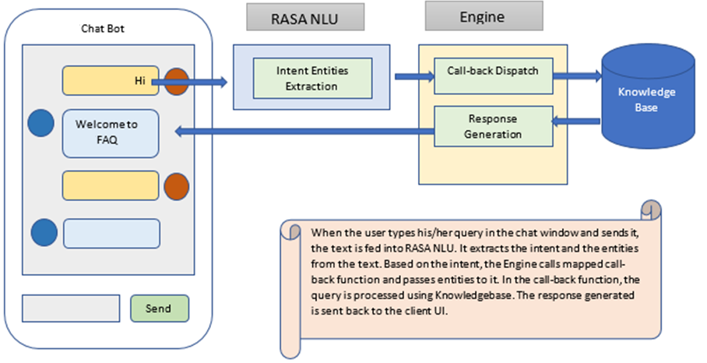
Architecture
Of the Pilot FAQ Chatbot
Answers are stored in Knowledge Base, and are pulled based on Input Intent and Entity to generate the response.

Slide 6
Definitions
FAQ
Questions (Ex: My Internet is down! ) |  | Answers
Intent | Entity
Service Interrupt | Intenet
Each FAQ/Q&As are composed of questions and answers.
Questions are broken into Intent & Entities.
Intent: Intention/Classification of the questions.
Entities: Key words in the questions.
While Training the bot with the historical data we need to define the Intent & Entities are defined.
NLP:
Refers to all the systems which handle the interactions with humans in the way humans find it natural. It means that we could converse with a system just the way we talk to other human beings.
Eg: Siri & GoogleNow
NLU
Subfield of NLP which handles a narrow but complex challenge of converting unstructured inputs into a structured form which a machine can understand and act upon.
Eg:- RASA NLU & Api.ai & Wit.ai

Slide 7
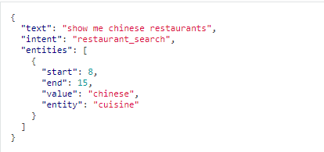
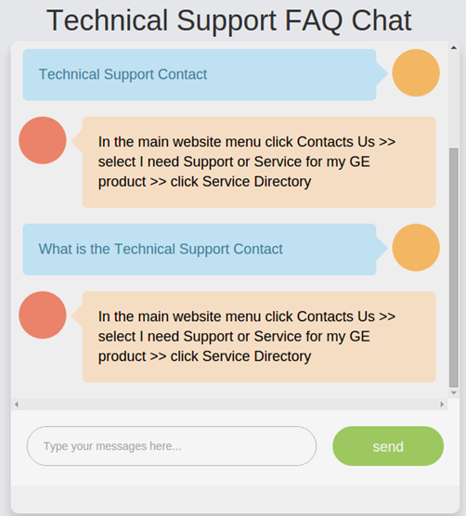
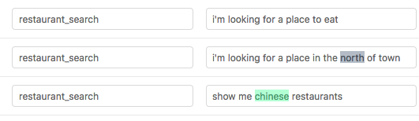
RASA NLU Installation
Installation Steps
Training data in JSON format
pip install rasa_nlu[spacy]
Install the RASA and the dependencies
python -m spacy download en_core_web_md
Download the work bag
python -m spacy link en_core_web_md en
Link the work bag with RASA
GUI Tool to generate Training data
GUI Tool to generate Training data
https://rasahq.github.io/rasa-nlu-trainer/

Slide 8
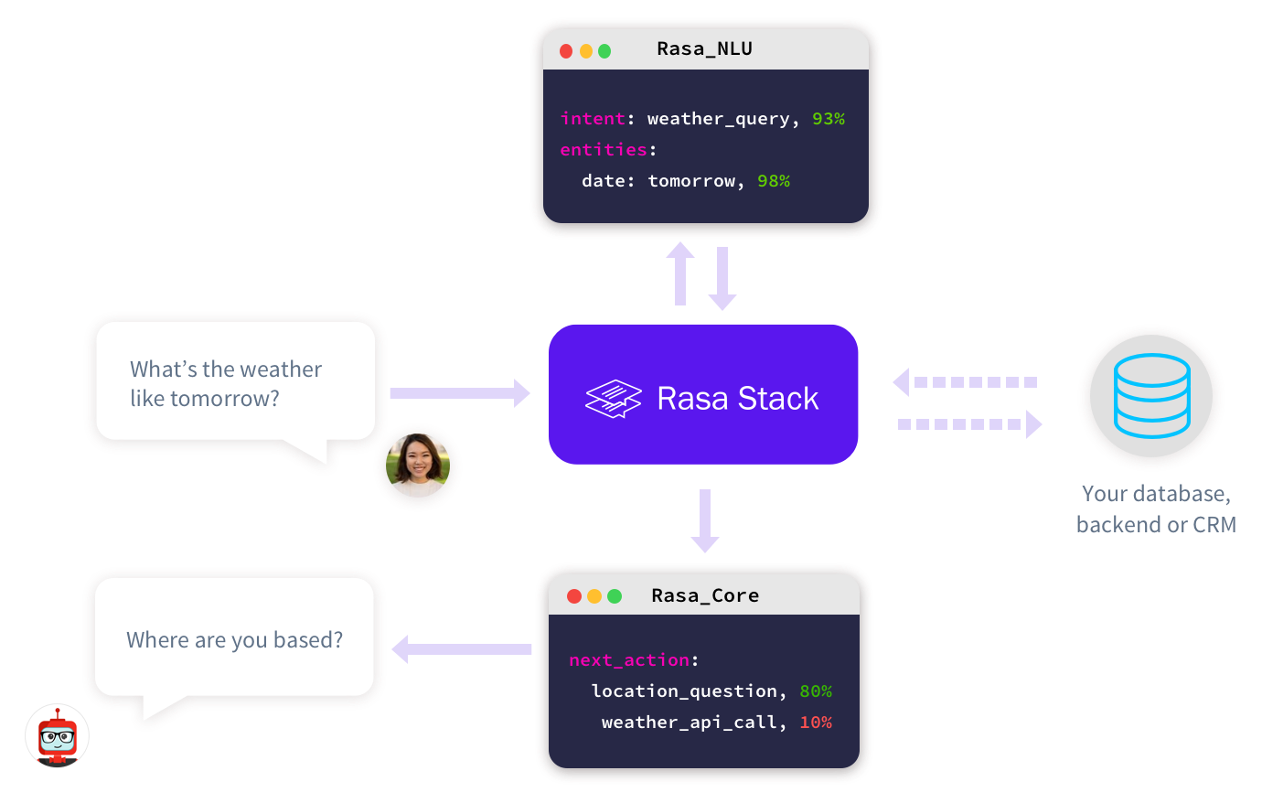
RASA NLU

Slide 9
Further Extensions Planned
Audio Chatbot - Speech to Text and vice-versa
Integrations with ServiceNow
Integrations with RPA such as UI Path to take the instructions and process the commands such as:
Access Provisioning
Adhoc Reports

Slide 10
Contents
Steps to Install → Slide 3
Steps to create training dataset → Slide 4 – 11
Programmatic changes → Slide 12 – 14
Running RASA NLU server → Slide 15
Running UI agent → Slide 16
References → Slide 17

Slide 11
Steps to Install RASA NLU on Windows
Run below commands from a command prompt one after the other (This will Instal RASA NLU with spaCy+sklearn pipeline)
pip instal rasa_nlu[spacy]
python -m spacy download en_core_web_md
python -m spacy link en_core_web_md en
Note:-
Pre requisite:
Python should be installed along with pip.
In case if you are facing error while installing
Try installing pywin32
pip install pypiwin32
2. If required install Visual C++ buildtools
3. For UI
pip install flask
Ref:-
https://nlu.rasa.ai/installation.html#best-for-most-spacy-sklearn

Slide 12
Steps to create training dataset
For the Question and Answers, you need to identify Intent and Entity for each question
Intent – This tells us what the user would like to do. i.e Intention of the question.
Eg: Raise a complaint, service request, etc
Entity – These are the attributes which gives details of the question. i.e keywords within the question
Eg: Internet down, Password reset, etc
Example 1:-
Question : FieldVision Work Country Missing Issue?
Answer: The country values were passing through as null to the CGE. This is because valid equipment IDs were not aligned to the project in ServiceMax, and so ServiceMax sent down null values
Here, The intent of the question can be classified as “data issue”, and the entities can be “FieldVision”, “Country Missing”, “Missing Issue”…
Example 2:-
Question : Hours in ST limited to 8 hours
Answer: Go to settings in the FieldVision app and adjust the limit for the maximum number of hours in straight time.
Here, The intent of the question can be classified as “timesheet”, and the entities can be “ST Hours”, “ST limited”, “8 hours”…

Slide 13
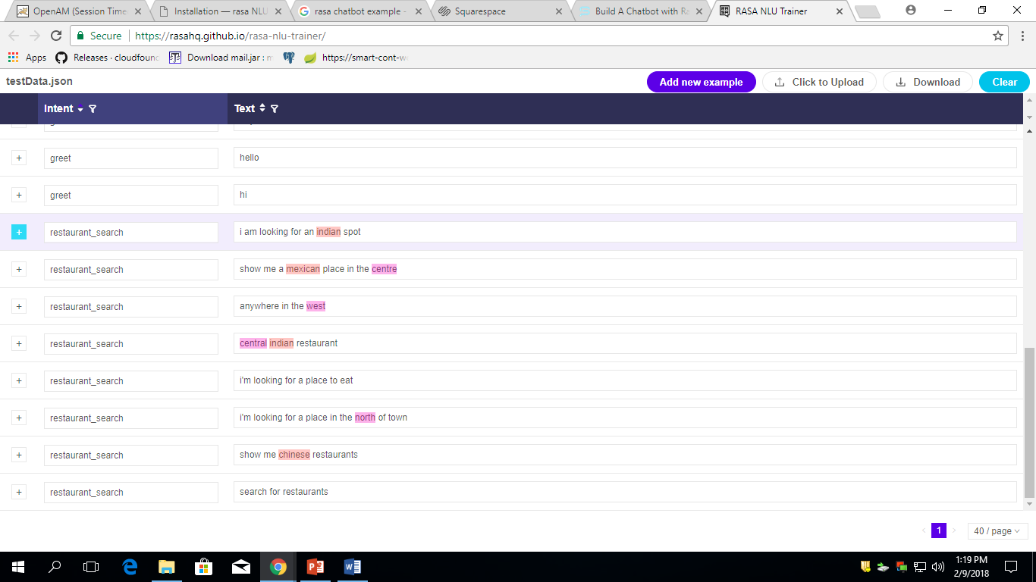
Steps to create training dataset cont….
Goto to below UI link for to enter training data
https://rasahq.github.io/rasa-nlu-trainer/

Slide 14
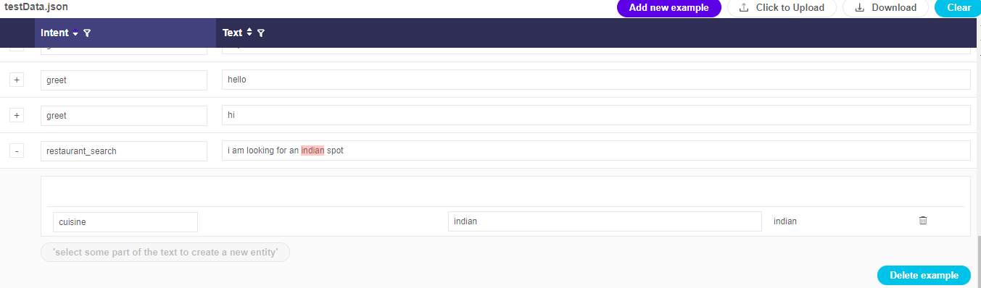
Steps to create training dataset cont….
Delete everything belonging to Intent -> “restaurant_search”, we don’t require them, they are given as sample.
1. Click to expand
2. Click to delete

Slide 15
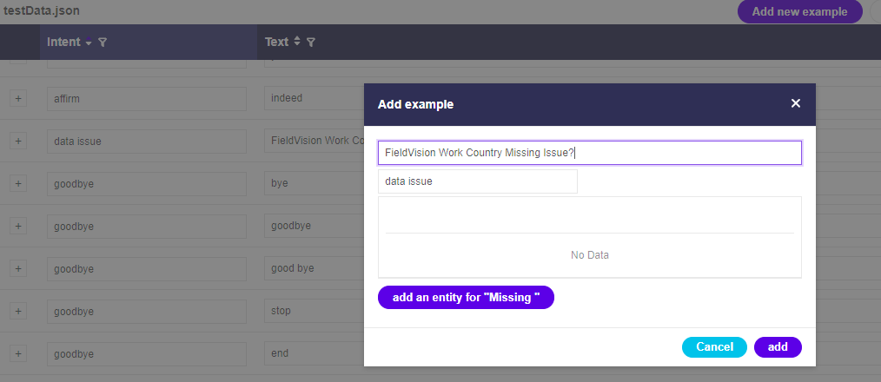
Steps to create training dataset cont….
Enter your question as shown below, and enter entity
2. Enter your question here
4. Click “add” to insert question
1. Click “Add new example” to insert question
3. Enter questions intent

Slide 16
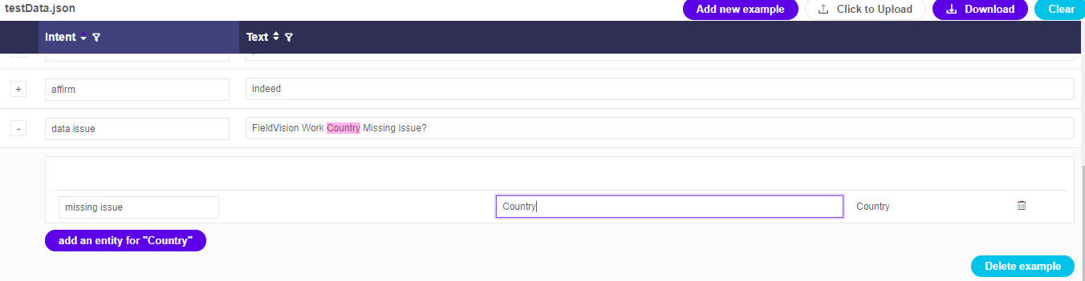
Steps to create training dataset cont….
Select your entities for your questions
3. Enter entityname.
Make sure its all lowercase.
Make sure there is no empty space before and after your selection. But empty spaces is allowed inbetween.
Entityname is unique to each question
2. Select text you want as entity.
Make sure there is no empty space before and after your selection. But empty spaces is allowed in between.
1. Click to expand

Slide 17
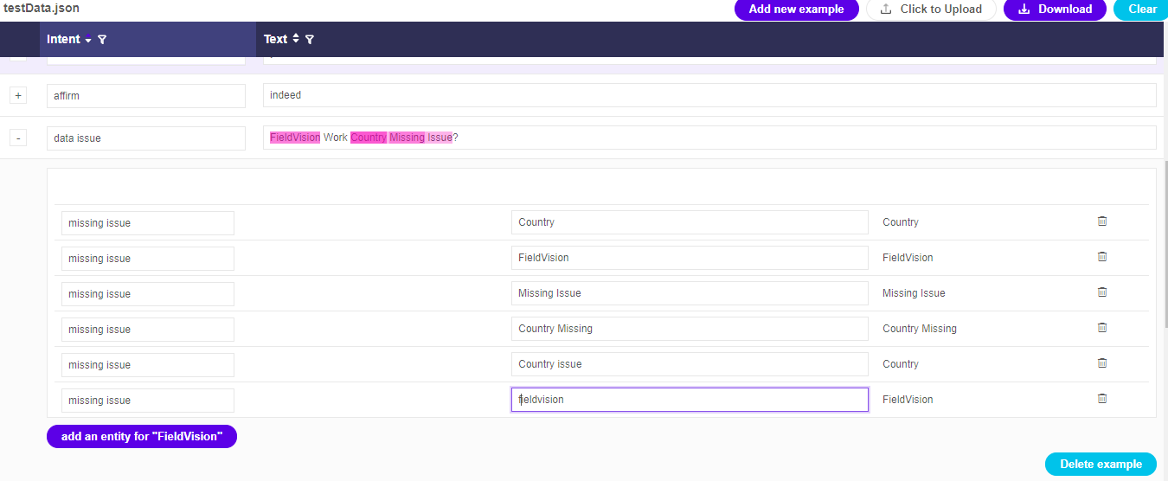
Steps to create training dataset cont….
Select as many entities as possible from your questions
3. Select as many entities as possible. These are the probable key words the user will enter inorder this question.
They can be single word
Group of words, consecutive words, alternate words, or any combination within the question.
Can also add synonyms for words
2. Entityname are unique to each question
1. Select text you want as entity

Slide 18
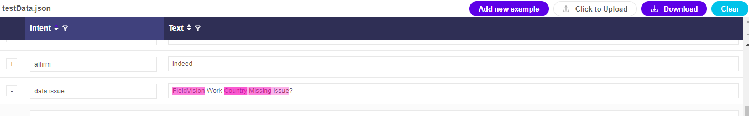
Steps to create training dataset cont….
After entering Intent and Entities for all the questions. Click Download button to download a json file (testData.json).
1. Click to download testData.json file
Please share below documents to technical team.
testData.json
Question and answer document.

Slide 19
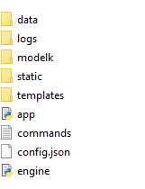
Programmatic Changes
Place the training json data in data folder, by renaming it to “Chatbot_trainingData.json”
2. Copy trainingData.json file
3. Enter your Intents here
4. Enter your entityname and their answers as python dictionary
1. Unzip the Chatbot Client

Slide 20
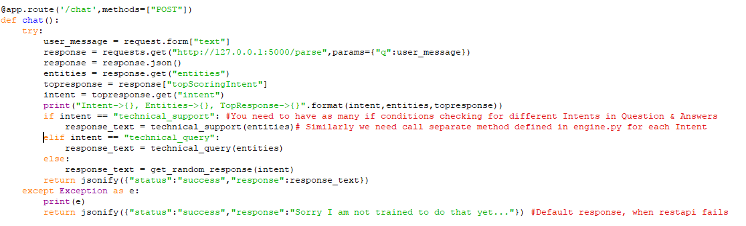
Programmatic Changes cont…
app.py program changes
Random response when no Intents matches
Change Intents based on your questions

Slide 21
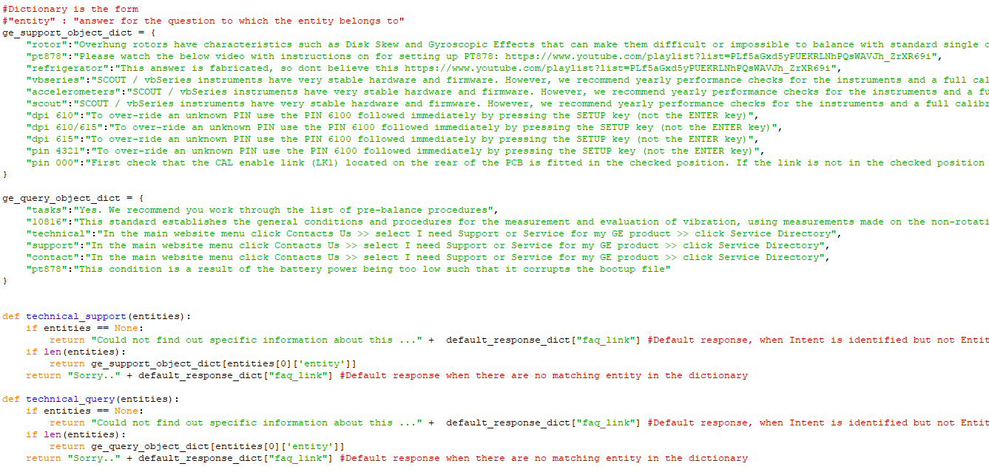
Programmatic Changes cont…
engine.py program changes
These are the functions called for which you have mapped to intents in your app.py
These python dictionaries are for each Intent, mapping entity to their answers.

Slide 22
Running the RASA NLU server
Once done with code changes, now its time to train the RASA NLU server and run it
Run below command from a command prompt to train the RASA NLU model: python -m rasa_nlu.train -c config.json
After training, Run below command from a command prompt to run the RASA NLU model: python -m rasa_nlu.server -c config.json -e luis

Slide 23
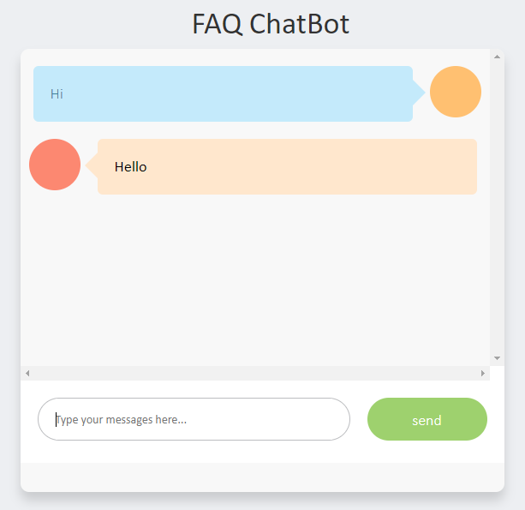
Running the UI agent
Once RASA NLU server is running. Now its time to run the UI agent.
In another command prompt, run below command python app.py
In the browser access 127.0.0.1:8080, and start chatting

Slide 24
References
RASA NLU Documantation
https://nlu.rasa.ai/installation.html
https://core.rasa.ai/installation.html
Build a chatbot with RASA NLU
https://blog.spg.ai/build-a-chatbot-with-rasa-nlu-dc2bfb55edb2
RASA NLU Training dataset
https://rasahq.github.io/rasa-nlu-trainer/

